Slide 1
LUNGS CANCER DETECTION BASED ON DEEP LEARNING BY USING CNN
GUIDED BY:
Mr.CYPTO.M.E.,
Assistant professor
Department of CSE
DMICE
SUBMITTED BY:
M.JAYALAKSHIMI (210517104038)
J.JENIFER (210517104044)
R.GAYATHRI (210517104030)

Slide 2
ABSTRACT :
Lung cancer is the world’s leading cause of cancer death. The convolutional neural network (CNN) has been proved able to classify between malignant and benign tissues on CT scan images. In this paper, a deep neural network is designed based on GoogleNet, a pre-trained CNN. To reduce the computing cost and avoid overfitting in network learning, the densely connected architecture of the proposed network was sparsified, with 60 % of all neurons deployed on dropout layers. The performance of the proposed network was verified through a simulation on a pre-processed CT scan image dataset: The Lung Image Database Consortium (LIDC) dataset, and compared with that of several pre-trained CNNs, namely, AlexNet, GoogleNet and ResNet50. The results show that our network achieved better classification accuracy than the contrastive networks

Slide 3
INTRODUCTION :
An Automatic Detection System of Lung Nodules based on Multi-group Patch-Based Deep Learning Network ,LIDC dataset is used where the input is multi-group 2D Lung CT Images.
It involves three steps. Lung contours are repaired using a slope analysis method. Later, the vessel-like structure in a CT image is eliminated by applying the Frangi Filter.
After that, the CNN structure is verified on two groups of images, one group contains original images, and the second group contains binary images generated through complex binarization processing to classify whether the nodule is cancerous or not.

Slide 4
Based on the centroid location of the malignant nodules, the researchers cropped the original images into smaller patches and used them as the cancer cases used Convolution Neural Networks.
proposed a method to detect nodules of lung CT Images using 3D Convolution Neural Networks along with traditional processing methods.
The image is transferred from grayscale to color (RGB). Later, a series of morphological operations are performed.
Finally, the connected area is the mask of the CT image.The researchers applied CNN and obtained 67.7 % accuracy.

Slide 5
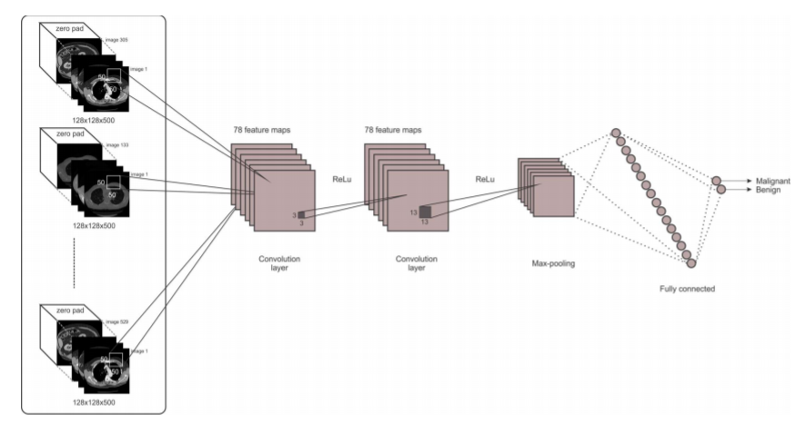
DATA FLOW DIAGRAM:

Slide 6
LITERATURE SERVEY:
TITLE | AUTHOR | YEAR OF PUBLICATION | ADVANTAGE | DISADVANTAGE
1.An automatic detection system of lung nodule based on multigroup patch-based deep learning network. | Jiang, H., Qian, W., Gao, M., Li, Y. | 2018 | Early detection of cancer greatly increases the chances for successful treatment. | The input image must have clarity to predict the correct output.
2. Deep learning for the classification of lung nodules. | Yang, H., Yu, H., Wang, G. | 2016 | With the use of this treatment is often simpler and more likely to be effective. | High computational cost.

Slide 7
TITLE | AUTHOR | YEAR OF PUBLICATION | ADVANTAGE | DISADVANTAGE
3. Lung nodule classification using deep features in CT images. | Kumar, D., Wong, A., Clausi, D.A | 2015 | using the annotation of all the radiologists as compared to many other similar approaches which use the best annotation for a slice or the annotation with largest area is that while testing in the real world, if one of the radiologists provide a partial annotation of a nodule our system would still work. | Accuracy is low.
4.Pulmonary nodule detection based on CT images using Convolution neural network. | Jin, X., Zhang, Y., Jin, Q. (2016). | 2016 | It uses circular filter in Region of interest extraction phase which reduces the cost of training and recognition steps. Although, implementation cost is reduced, it has still unsatisfactory accuracy. | Time is more required.

Slide 8
MODULES SPLIT UP:
Data Collection
Image Pre-Processing
Convolution Neural network algorithm

Slide 9
Data Collection:
The Kaggle DR Detection mission dataset includes color
fungus photographs.
Data collection largely consists of data acquisition, data labeling, and improvement of existing data or models.
Data collection can be divided into two parts.
Training Data
Testing Data
The observations in the training set form the experience that the algorithm uses to learn. In supervised learning problems, each observation consists of an observed output variable and one or more observed input variables.

Slide 10
IMAGE PREPROCESSING
For this experiment, Lung Image Database Consortium (LIDC) dataset is used. This data set contains the computed tomography (CT) scans of patients. It also contains an XML file for each patient, which contains the individual annotations marked by the radiologists.
To work with the dataset, several CT slices of each patient are retrieved based on the XML file and are placed in a directory.
For the binary classification, the malignancy characteristics of the annotations given in the XML file is considered. If the Malignancy rating is greater than 3, all the patient slices are considered as malignant. And if the Malignancy rating is less than or equal to 3, those slices are considered as benign slices.

Slide 11
The LIDC dataset images are available in DICOM format. These medical images are stored with the .dcm format. To do the experiment for effective classification of images, images are converted into the .jpg format along with the same labels.
The converted images are stacked in two separate directories named as benign and malignant. No further preprocessing methods are applied on images; raw images are fed to the network directly.

Slide 12
CONVOLUTION NEURAL NETWORK
Neural network is divided into three layers.
First layer being the input layer, the second as the hidden layer and the third layer is the output layer.
Input Layer: This input layer accepts raw images and forwarded to further layers for extracting features.
Convolution Layer: After the input layer, the next layer is the convolution layer. In this layer, the number of filters is applied to images for finding features from images. These features are used for calculating the matches at the testing.
The convolution is defined as a product of f and g object functions. The two function f and g over a range of [0,t] is given in Eq. (1):
[𝑓 ∗ 𝑔](𝑡) = ∫ 𝑓(𝜏)𝑔(𝑡 − 𝜏)𝑑𝜏 𝜏 0 (1)
where,[f*g](t) indicates the convolution of f and g.

Slide 13
The Proposed network applied with input size as 227×227×3 (color image). It uses 7×7 filters, with stride 2.
After applying the convolution the output size is 111×111. The convolution output size is computed using Eq. (2):
[ 𝑊−𝑓+2𝑝 𝑠 ]+ 1 (2)
where, W×H (Width×Height) is 227×227, filter (f) is 7×7, stride (s) is 2 and padding (p) is 0. So, the output 111×111 is forwarded to the pooling layer.
Similarly, all convolutional layers are computed inside the network. This computation is called abstract computation.

Slide 14
Pooling: Extracted features are sent to the pooling layer. This layer captures large images and reduces them, and reduces the parameters to preserve important information. It preserves the maximum value from each window. We applied the max-pooling; the output from the convolution layer is input matrix to pooling layer is used.
We applied the max-pooling; the output from the convolution layer is input matrix to pooling layer is calculated using Eq. (3):
[ 𝐼+2𝑝−2 𝑠 ] + 1

Slide 15
CONVOLUTION NEURAL NETWORK
Sparse Layer: This layer is the combination of convolutional layers (conv 1×1, conv 3×3, conv 5×5) and the result from these layers are concatenated to the next layer of the model.
Softmax Layer: This layer present just before the output layer. This layer gives the decimal probabilities is used. Those decimal probabilities are in between 0 and 1, which can predict n different classes, the feature will be stored into x, which is a column vector.
𝑝(𝑦 = 𝑗|𝑥, 𝜃) = 𝑒 𝜃 𝑥𝑗 𝑇 ∑ 𝑒 𝜃 𝑥𝑗 𝑇 𝑘 𝑗=1 (4)
where, k is the target classes 𝜃𝑗 𝑇 is a weight vector.

Slide 16
CONVOLUTION NEURAL NETWORK
So, we will make use of a Convolutional neural network. The pre-processed data is fed into the input layer of the Convolutional neural network. At the time of reading the pre-processed data, a filter is applied which helps in decreasing the dimensions of the input data.
We can further decrease the data by applying max-pooling or min-pooling.
We will calculate the error between the predicted outcome and the expected outcome. We then update the weights accordingly to get the desired result. And this process is known as backward-error propagation.

Slide 17
CONCLUSION:
A convolutional neural network based system was implemented to detect the malignancy tissues present in the input lung CT image.
Lung image with different shape, size of the cancerous tissues has been fed at the input for training the system.
It was used to detect the cancer in the lungs.
We got an accuracy of 0.86 which is good measure for a ConvolutionNeural Network.
The Model predicts the lungs affected or not with good efficiency.

Slide 18
FEATURE ENHANCEMENT:
Future scope is Lung Cancer Detection using convolutional neural network minimizes the time of predicting the lungs is affected by cancer or not.
These networks classify the CT scan images as benign or malignant

Slide 19
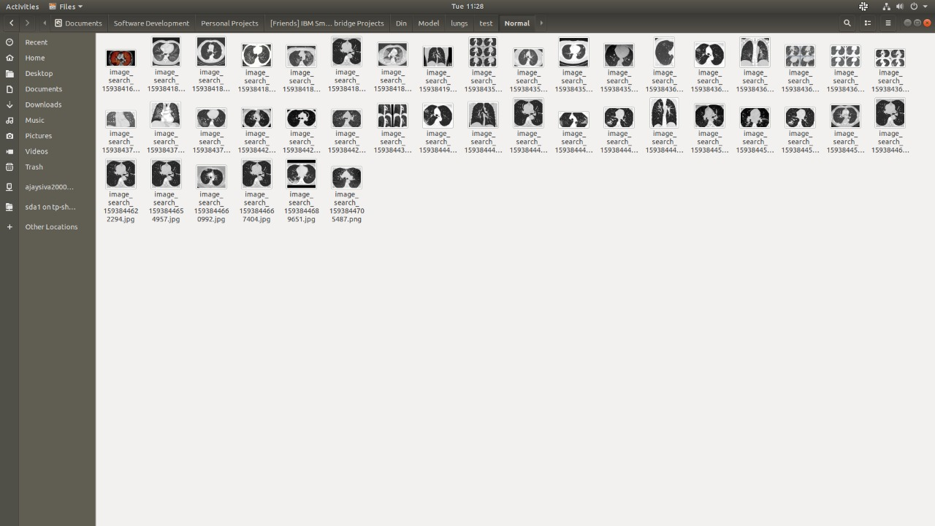

Slide 20
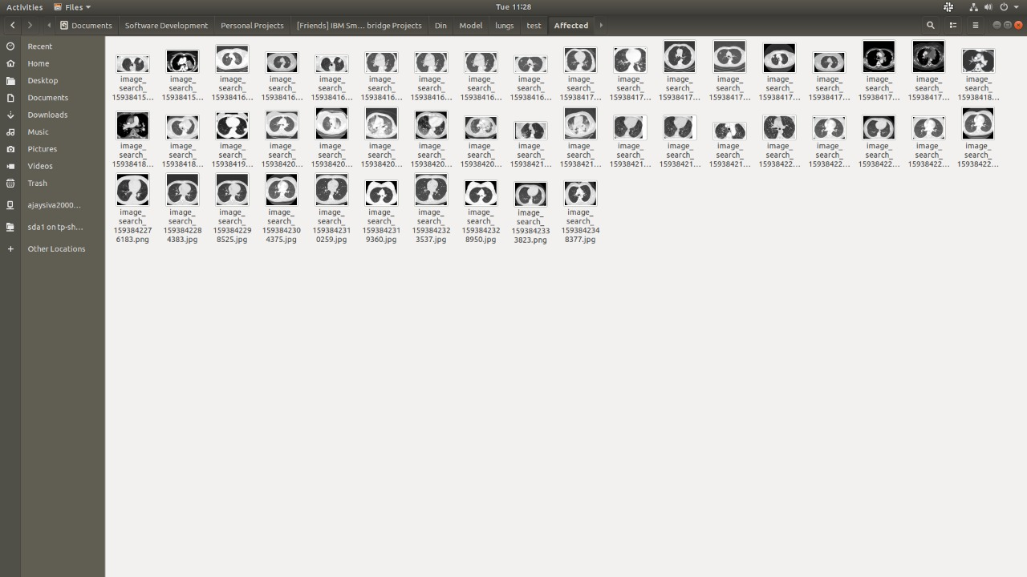

Slide 21
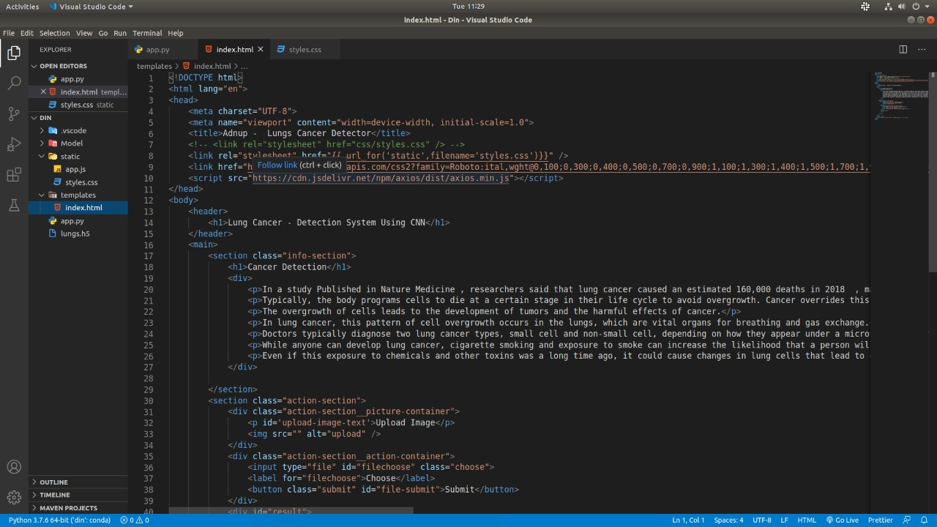

Slide 22
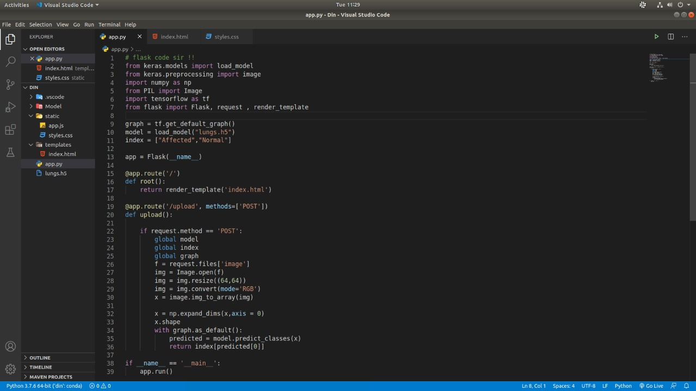

Slide 23
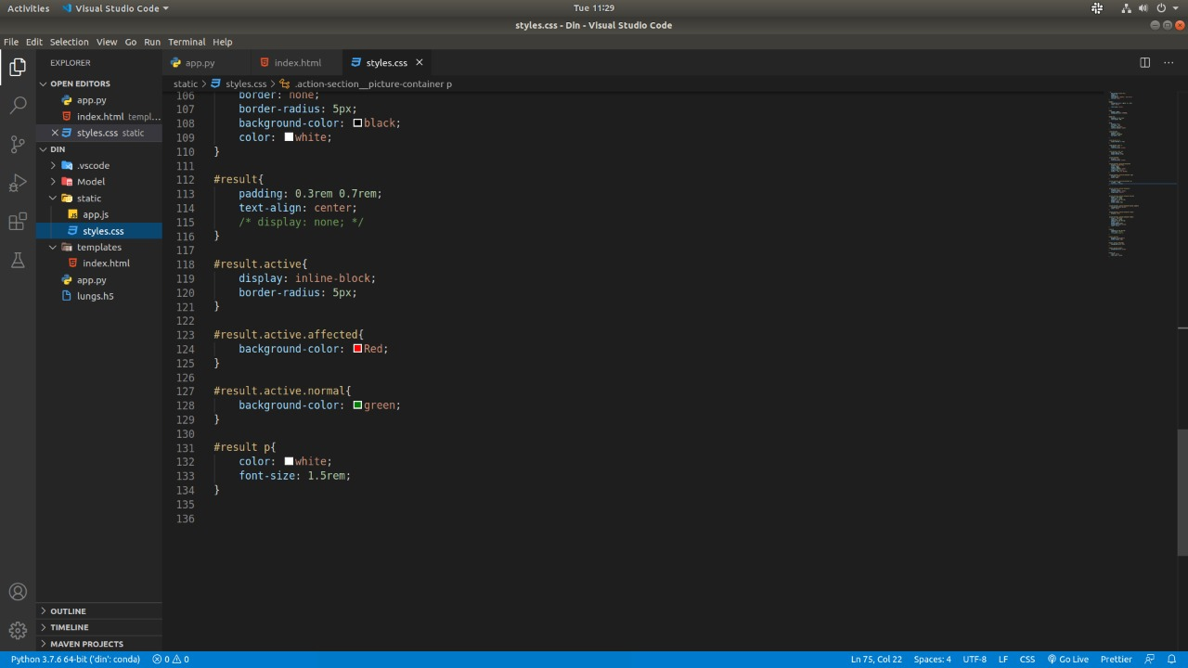

Slide 24
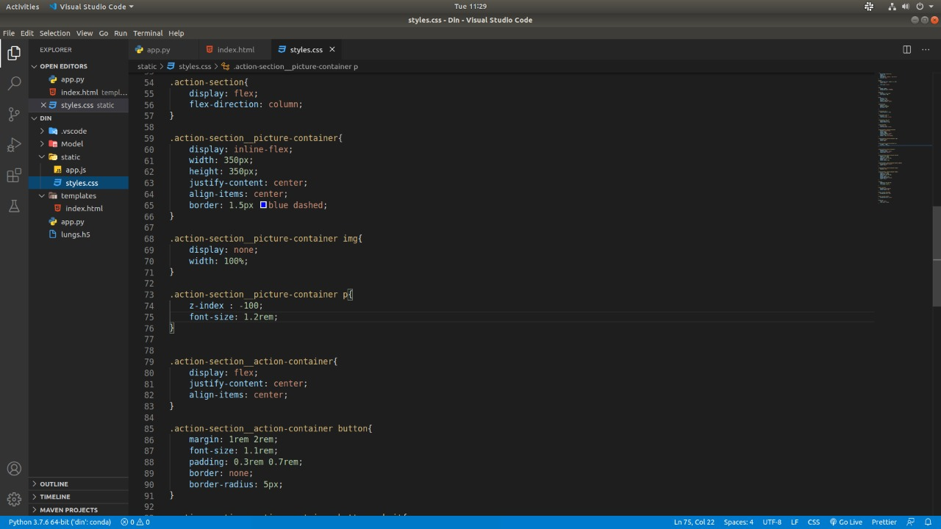

Slide 25
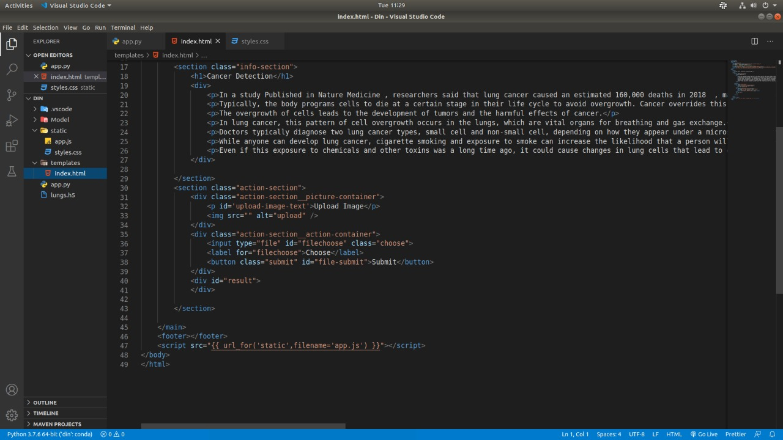

Slide 26
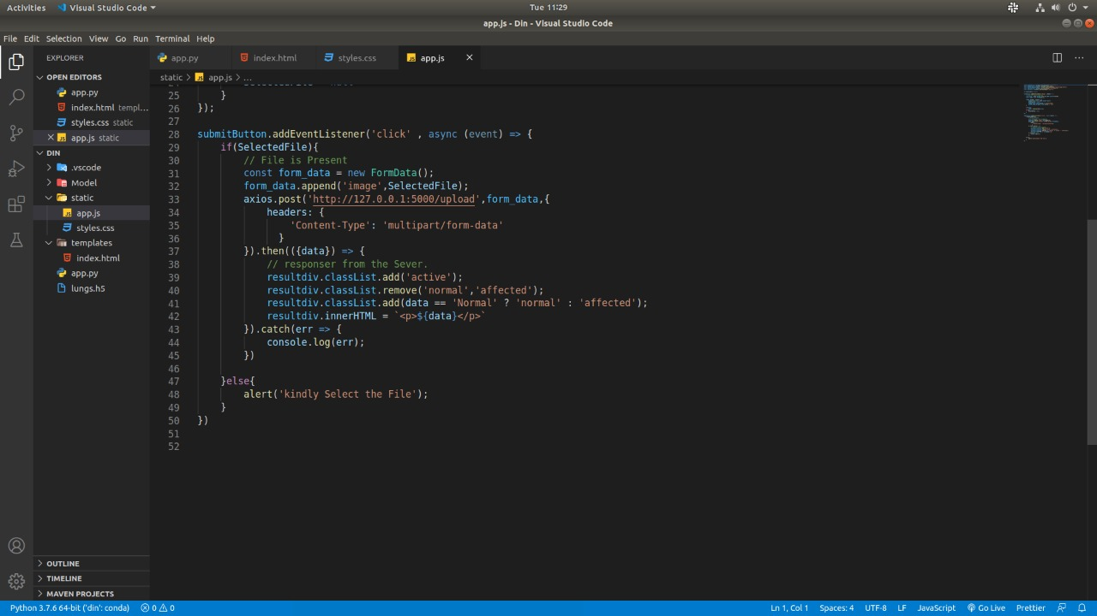

Slide 27
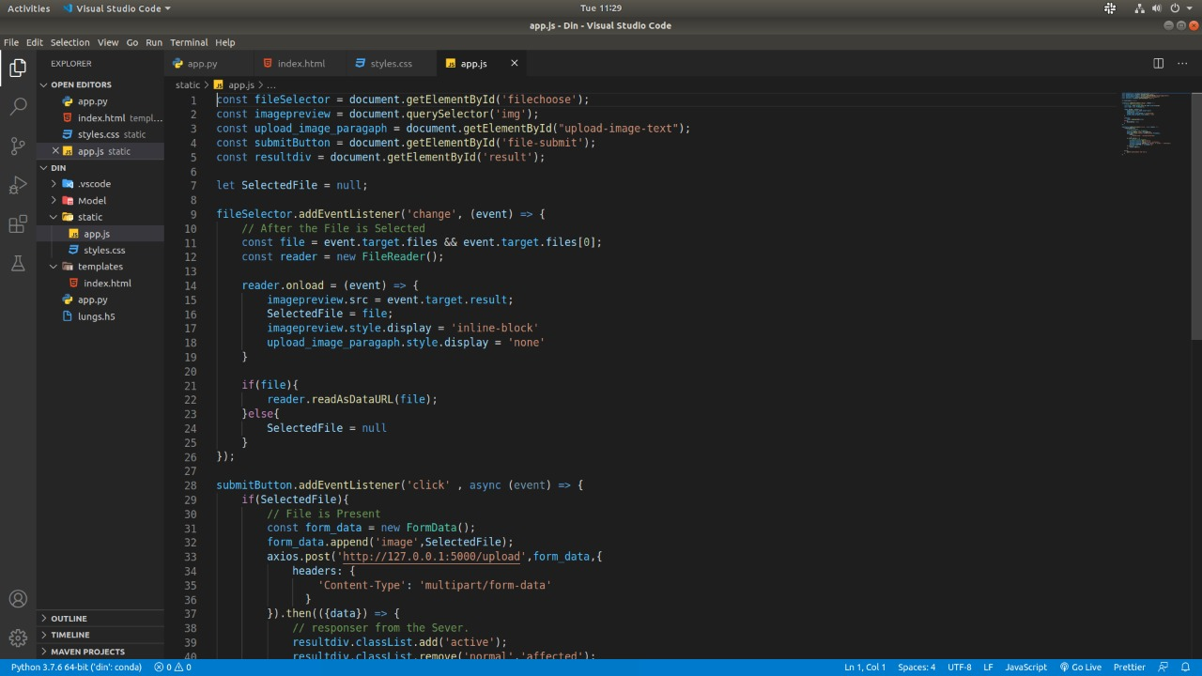

Slide 28
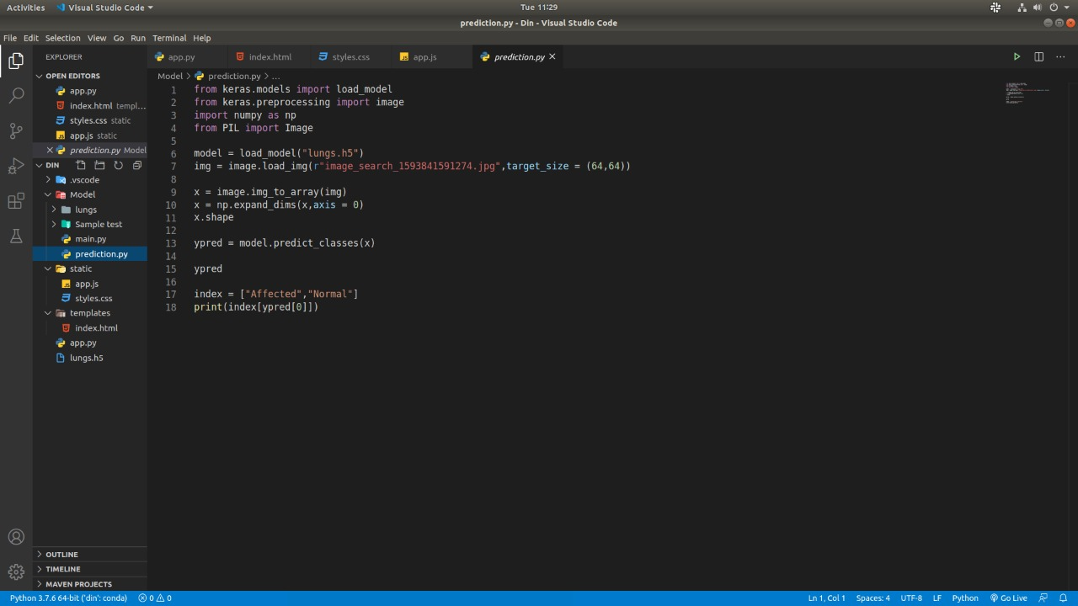

Slide 29
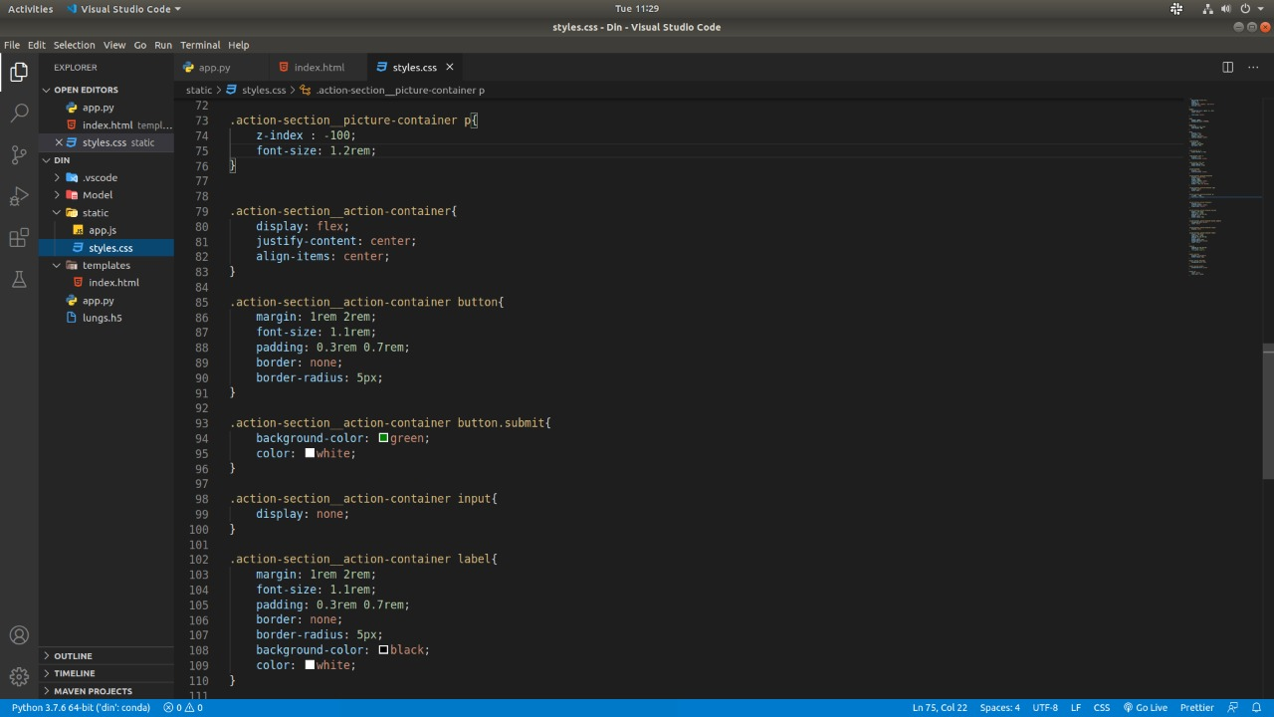

Slide 30
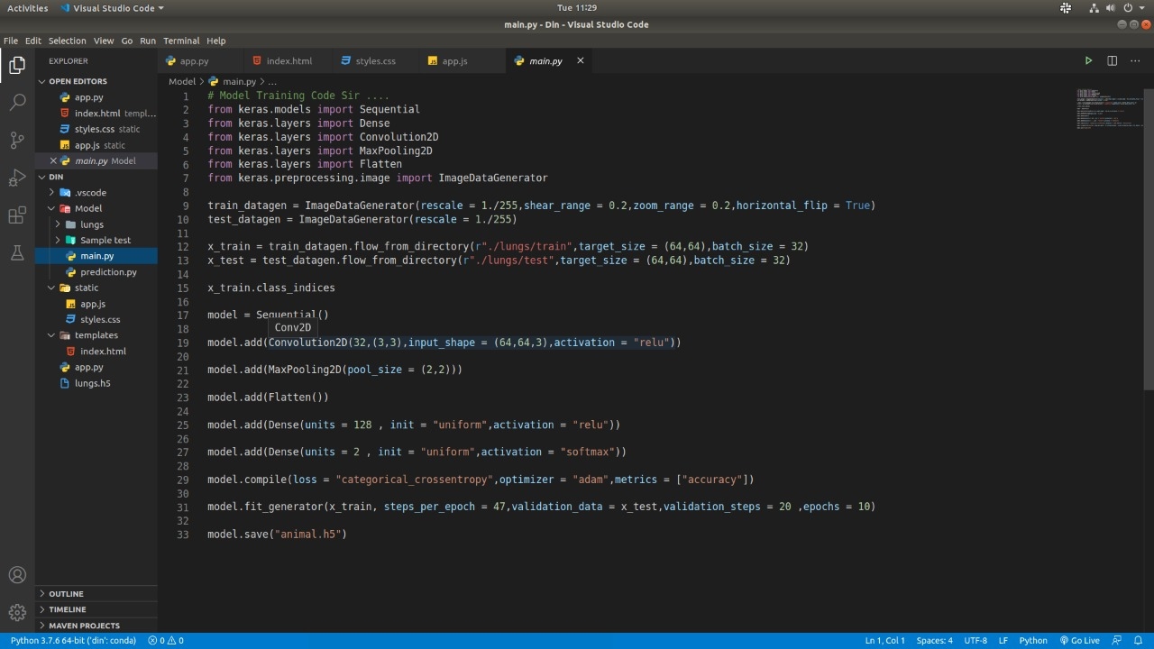

Slide 31
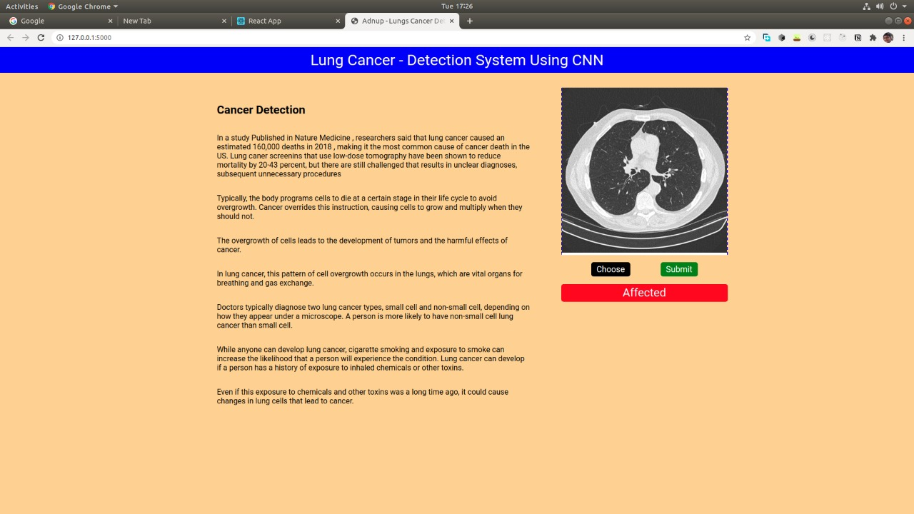

Slide 32
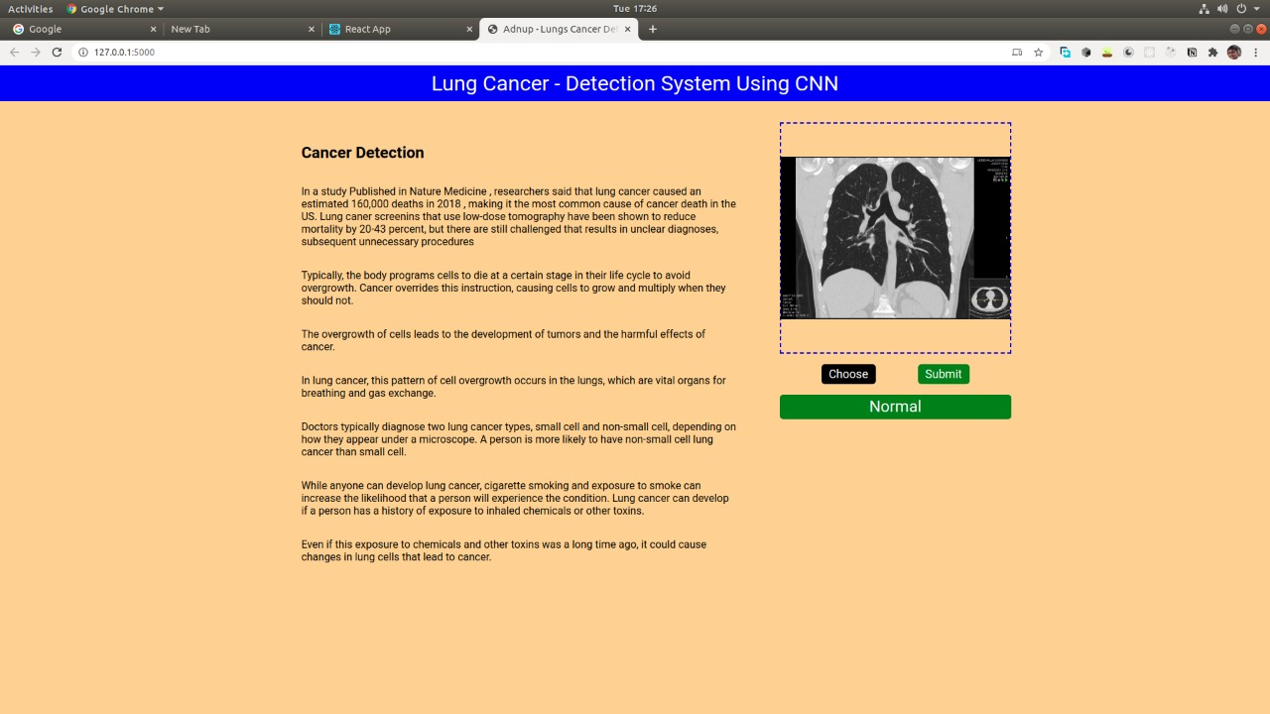

Slide 33
REFERENCE:
[1]Jiang, H., Qian, W., Gao, M., Li, Y. (2018). An automatic detection system of lung nodule based on multigroup patch-based deep learning network.
[2]Yang, H., Yu, H., Wang, G. (2016). Deep learning for the classification of lung nodules.
[3]Fan, L., Xia, Z., Zhang, X., Feng, X. (2017). Lung nodule detection based on convolutional neural networks.
[4]Jin, X., Zhang, Y., Jin, Q. (2016). Pulmonary nodule detection based on CT images using Convolution neural network.

Slide 34
[5] A. Chon, N. Balachandar, and P. Lu, “Deep convolutional neural networks for lung cancer detection.
[6]G. Wu, M. Kim, Q. Wang, Y. Gao, S. Liao, and D. Shen, “Unsupervised deep featu Y. Xu, T. Mo, Q. Feng, P. Zhong, M. Lai, and E. I. Chang, “Deep learning of feature representation with multiple instance learning for medical image analysis.
[7] R. Golan, C. Jacob, and J. Denzinger, “Lung nodule detection in ct images using deep convolutional neural networks.
[8] Lyu, J., Ling, S.H. (2018). Using multi-level convolutional neural network for classification of lung nodules on CT images.

Slide 35
THANK YOU

